Slide 1
Guide to Accessing Course Materials via FTP with FileZilla
Takeru Miyata
2025.09.08

Slide 2
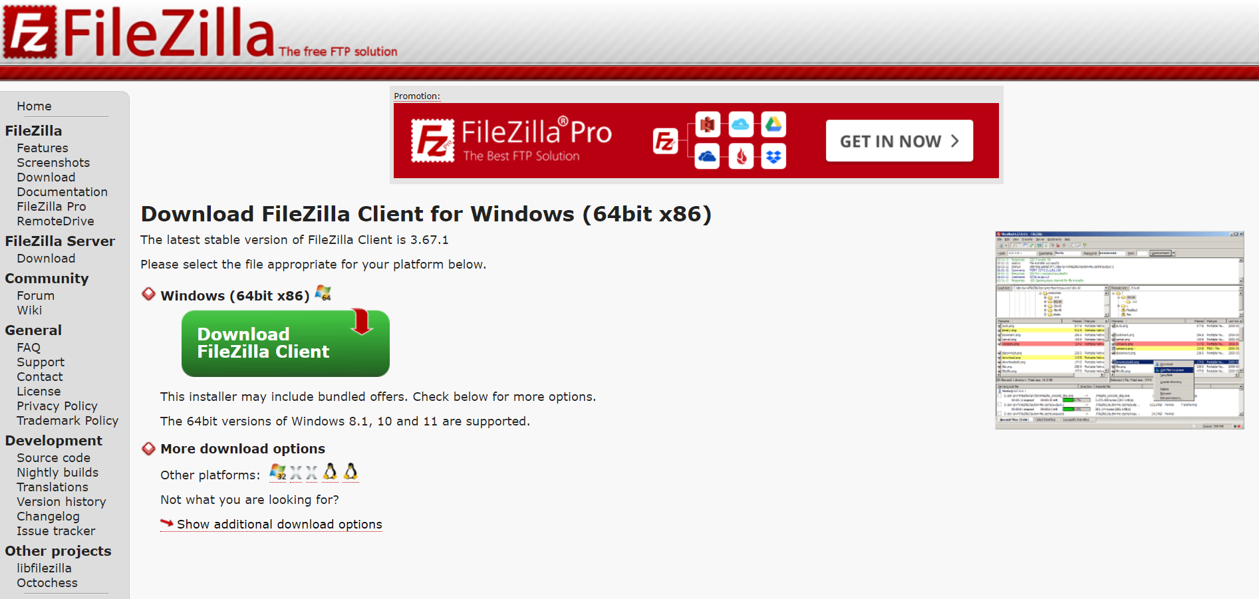
Step 1: Install Filezilla Client
https://filezilla-project.org/download.php?type=client#close

Slide 3
Step 2: Connect to the school network
If you’re on campus,
make sure your device is connected to the school Wi-Fi.
If you’re off-campus,
connect to the school‘s VPN.
You can refer to this link to connect to the VPN.
https://cc.ncku.edu.tw/p/412-1213-7637.php?Lang=en

Slide 4
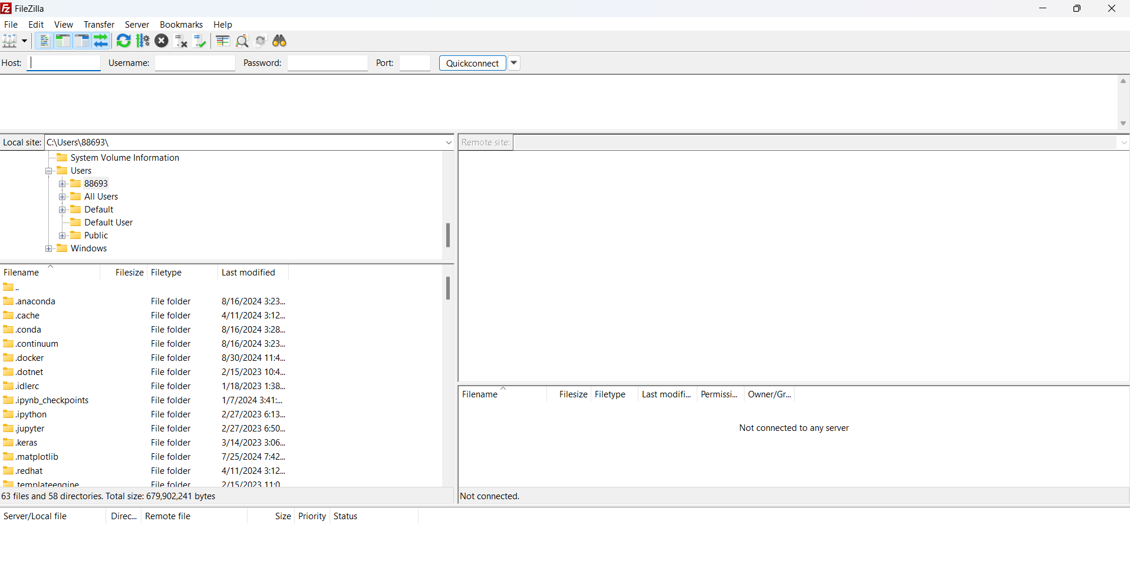
Step 3: Open FIlezilla

Slide 5
Step 4: Input the following information
RL2025opencv
Host: 140.116.154.28
Username: opencvdl2025
Password: RL2025opencv
Port: Leave it as default, or set to 21 (不用輸入)

Slide 6
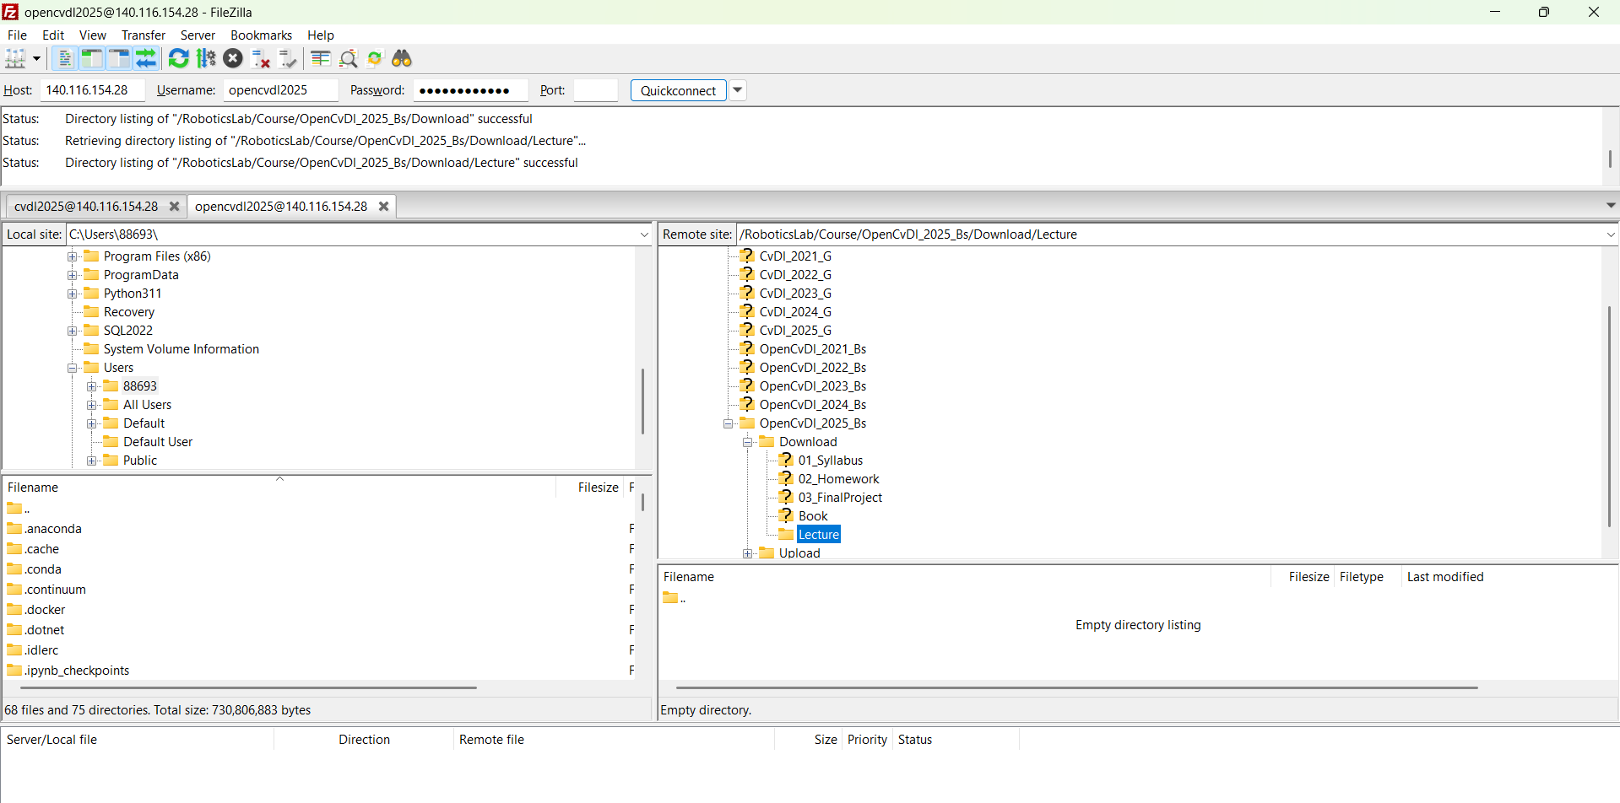
Step 5: Connect
Click on Quickconnect. Once connected, you'll be able to see the server’s files in the right-hand pane and your local files on the left.

